Slide 1
Map Design

Slide 2
Thematic Data :
Features of one type that are generally placed together in a single layer
Data of any specific topic
Only information about same theme over the range
Building block for thematic maps
All data are of same type
Overall collected information are finally grouped or generalized with some specific information

Slide 3
Data Classification :
is broadly defined as the process of organizing data by relevant categories so that it may be used and protected more efficiently.
According to Horace Secrist, "Classification is the process of arranging data into sequence and groups according to their common characteristics or separating them into different but related parts.
On a basic level, the classification process makes data easier to locate and retrieve.
Data classification is of particular importance when it comes to risk management, compliance, and data security.
Data classification involves tagging data to make it easily searchable and trackable.
It also eliminates multiple duplications of data, which can reduce storage and backup costs while speeding up the search process.

Slide 4
Importance of Data Classification
To make the data simple and brief : The main objective of classification is to condense the large data to make them easily understood
Helps in Comparison: it facilitates comparison. Ungrouped and shapeless data cannot be computed.
To reveal the basis tabulation: Classification provides basis for tabulation. No tabulation is possible without classification.
To bring out points of similarities and dissimilarities : Classification reveals clearly the points of similarities and dissimilarities in the statistical data.

Slide 5
Common Method of data classification
Equal Intervals
Quantiles
Mean-Standard Deviation
Geometric Interval
Natural Breaks
Defined Interval

Slide 6
Equal Interval
Use equal interval is to divide the range of attribute values into equal-sized subranges.
This allows you to specify the number of intervals, and the class breaks based on the value range are automatically determined.
Equal interval is best applied to familiar data ranges, such as percentages and temperature.
This method emphasizes the amount of an attribute value relative to other values.
For example, it shows that a shop is part of the group of shops that make up the top one-third of all sales.

Slide 7
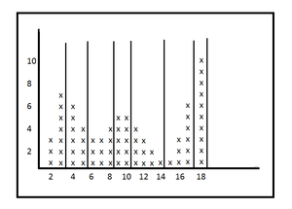
Quantiles
In a quantile classification each class contains an equal number of features.
A quantile classification is well suited to linearly distributed data.
Quantile assigns the same number of data values to each class.
There are no empty classes or classes with too few or too many values.
Because features are grouped in equal numbers in each class using quantile classification, the resulting map can often be misleading.
Similar features can be placed in adjacent classes, or features with widely different values can be put in the same class.
We can minimize this distortion by increasing the number of classes.

Slide 8
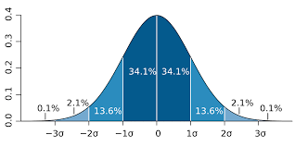
Mean Standard Deviation
The standard deviation classification method shows you how much a feature's attribute value varies from the mean.
The mean and standard deviation are calculated automatically.
Class breaks are created with equal value ranges that are a proportion of the standard deviation—usually at intervals of one, one-half, one-third, or one-fourth standard deviations using mean values and the standard deviations from the mean.

Slide 9
Geometrical Interval
Geometrical interval classification is a type of classification scheme for classifying a range of values based on a geometric progression.
In this classification scheme, class breaks are based on class intervals that have a geometrical series.
This classification method is useful for visualizing data that is not distributed normally, or when the distribution is extremely skewed.
The Geometrical intervals classification is better than quantiles for visualizing prediction surfaces, which often do not have a normal data distribution.
Geometric interval works best when the data is spread over a large area and is not well distributed.
The geometrical interval method is similar to a progression classification (binary, geometric, logarithmic, etc.), but it adds a coefficient.
Since this method is really intended to be used as part of a data visualization process, it should be noted that it may not be very useful as a data presentation method unless there is a compelling quantitative reason.
Best practices may include using a histogram with the class breaks overlaid to show the map audience what the classes mean relative to the data's distribution.

Slide 10
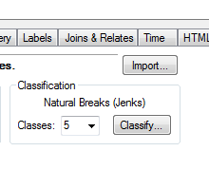
Natural Breaks
With natural breaks classification (Jenks) classes are based on natural groupings inherent in the data.
Class breaks are identified that best group similar values and that maximize the differences between classes.
The features are divided into classes whose boundaries are set where there are relatively big differences in the data values.
Natural breaks are data-specific classifications and not useful for comparing multiple maps built from different underlying information.
This classification is based on the Jenks Natural Breaks algorithm.

Slide 11
Defined Interval
Defined class value
Allows us to specify an interval by which to equally divide a range of attribute values
Rather than specifying the number of intervals as in the equal interval classification scheme, with this scheme, you specify the interval value.
ArcMap automatically determines the number of classes based on the interval

Slide 12
To be Continued..

